Slide 1
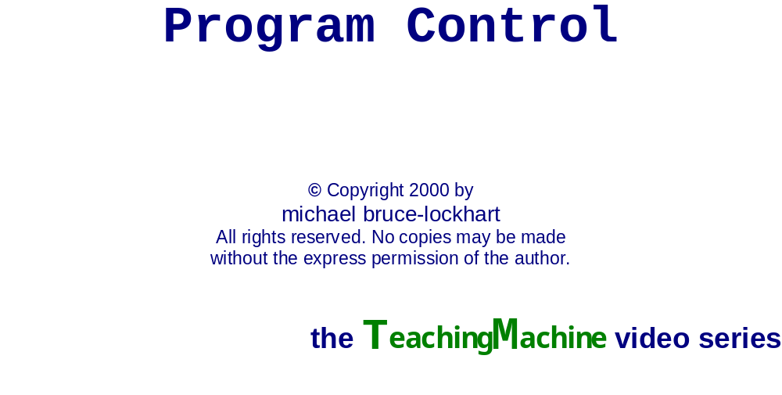

Slide 2
Apply to a
University
reapply to a
University
Set
i = 1
yes
Accepted?
no
Accepted?
yes
Get
Scholarship?
no
no
Set
i
yes
Lifetime
McJob
Year
i
yes
yes
no
Pass?
Keep
Scholarship?
Family
Sympathetic?
no
McJob
yes
no
Credits
to grad?
no
i = i + 1
McJob
no
Had
enough?
yes
yes
no
Real Job
Offer?
yes
no
Got
enough?
40 years of
mortgages &
car loans
yes

Slide 3

Apply to a
University
reapply to a
University
Set
i = 1
yes
Accepted?
no
Accepted?
yes
Get
Scholarship?
no
Spaghetti code
no
Set
i
yes
Lifetime
McJob
Year
i
yes
yes
no
Pass?
Keep
Scholarship?
Family
Sympathetic?
no
McJob
yes
no
Credits
to grad?
no
i = i + 1
McJob
no
Had
enough?
yes
yes
no
Real Job
Offer?
yes
no
Got
enough?
40 years of
mortgages &
car loans
yes

Slide 4
Djkestra’s Control Flows
Simple Sequence

Slide 5
Dijkstra’s Control Flows
Simple Sequence
Decision
true
false

Slide 6
Djkestra’s Control Flows
Simple Sequence
Decision
Loop

Slide 7
Simple Sequence
int main(){
  int i;
  i = 10;
  cout << “i = “ << i;
  return 0;
}

Slide 8
Simple Sequence
int main(){
  int i;
  i = 10;
  cout << “i = “ << i;
  return 0;
}

Slide 9
Simple Sequence
int main(){
  int i;
  i = 10;
  cout << “i = “ << i;
  return 0;
}

Slide 10
Simple Sequence
int main(){
  int i;
  i = 10;
  cout << “i = “ << i;
  return 0;
}

Slide 11
Simple Sequence
int main(){
  int i;
  i = 10;
  cout << “i = “ << i;
  return 0;
}

Slide 12
Decisions
// output a complex number
cout << '(' << real;
if (imaginary < 0) {
  cout << " - j";
  cout << -imaginary;
}
else {
  cout << " + j";
  cout << imaginary;
}
cout << ')';
true
false

Slide 13
Decisions
// output a complex number
cout << '(' << real;
if (imaginary < 0) {
  cout << " - j";
  cout << -imaginary;
}
else {
  cout << " + j";
  cout << imaginary;
}
cout << ')';
false
true
then
else

Slide 14
Decisions
// output a complex number
cout << '(' << real;
if (imaginary < 0) {
  cout << " - j";
  cout << -imaginary;
}
else {
  cout << " + j";
  cout << imaginary;
}
cout << ')';
false
true
then
else

Slide 15
Decisions
// output a complex number
cout << '(' << real;
if (imaginary < 0) {
  cout << " - j";
  cout << -imaginary;
}
else {
  cout << " + j";
  cout << imaginary;
}
cout << ')';
false
true
then
else

Slide 16
Decisions
// output a complex number
cout << '(' << real;
if (imaginary < 0) {
  cout << " - j";
  cout << -imaginary;
}
else {
  cout << " + j";
  cout << imaginary;
}
cout << ')';
false
true
then
else

Slide 17
Decisions
// output a complex number
cout << '(' << real;
if (imaginary < 0) {
  cout << " - j";
  cout << -imaginary;
}
else {
  cout << " + j";
  cout << imaginary;
}
cout << ')';
false
true
then
else

Slide 18
Decisions
// output a complex number
cout << '(' << real;
if (imaginary < 0) {
  cout << " - j";
  cout << -imaginary;
}
else {
  cout << " + j";
  cout << imaginary;
}
cout << ')';
false
true
then
else

Slide 19
Decisions
// output a complex number
cout << '(' << real;
if (imaginary < 0) {
  cout << " - j";
  cout << -imaginary;
}
else {
  cout << " + j";
  cout << imaginary;
}
cout << ')';
false
true
then
else

Slide 20
Decisions
// output a complex number
cout << '(' << real;
if (imaginary < 0) {
  cout << " - j";
  cout << -imaginary;
}
else {
  cout << " + j";
  cout << imaginary;
}
cout << ')';
false
true
then
else

Slide 21
Decisions
// output a complex number
cout << '(' << real;
if (imaginary < 0) {
  cout << " - j";
  cout << -imaginary;
}
else {
  cout << " + j";
  cout << imaginary;
}
cout << ')';
false
true
then
else

Slide 22
Single Clause Decision
// test for real root
double radical = b*b - 4*a*c;
if (radical > 0) {
  cout << "the roots are real\n";
}
cout << "Proceeding to next test\n";
false
true
then

Slide 23
Loops
int i = 0;
while (i <= 10){
  cout << i << ":\t";
  cout << i*i << '\n';
  i++;
}
cout << "That was 11 squares.";
true

Slide 24
Loops
int i = 0;
while (i <= 10){
  cout << i << ":\t";
  cout << i*i << '\n';
  i++;
}
cout << "That was 11 squares.";
true

Slide 25
Loops
int i = 0;
while (i <= 10){
  cout << i << ":\t";
  cout << i*i << '\n';
  i++;
}
cout << "That was 11 squares.";
true

Slide 26
Loops
int i = 0;
while (i <= 10){
  cout << i << ":\t";
  cout << i*i << '\n';
  i++;
}
cout << "That was 11 squares.";
true

Slide 27
Loops
int i = 0;
while (i <= 10){
  cout << i << ":\t";
  cout << i*i << '\n';
  i++;
}
cout << "That was 11 squares.";
true

Slide 28
Loops
int i = 0;
while (i <= 10){
  cout << i << ":\t";
  cout << i*i << '\n';
  i++;
}
cout << "That was 11 squares.";
true

Slide 29
Loops
int i = 0;
while (i <= 10){
  cout << i << ":\t";
  cout << i*i << '\n';
  i++;
}
cout << "That was 11 squares.";
true

Slide 30
Loops
int i = 0;
while (i <= 10){
  cout << i << ":\t";
  cout << i*i << '\n';
  i++;
}
cout << "That was 11 squares.";
true

Slide 31
Compound Control
true

Slide 32
Compound Control
true
true

Slide 33
Compound Control
true
false
true
true

Slide 34

Compound Control
true
false
true
true
Hierarchy

Slide 35
Non-Hierarchial Control
true
false
true

Slide 36
Non-Hierarchial Control
X
true
false
true

Slide 37
